Slide 1
I400 – Application Development in Java
Lecture 2

Slide 2
Today
CH 2 - Language Basics
Input & Output
Arithmetic Operators
If you miss anything today, please note that all slides from lecture are posted to Canvas.

Slide 3
Labs
We do have Lab this week!
Kay’s section’s lab meets in WY 125.
J’s section’s lab meets in IF 0006 (the same room as the lecture)

Slide 4

Console Input and Output
Java uses System.out for the standard output (monitor, console), and System.in for the standard input (keyboard).

Slide 5
Console Input and Output
Output to the console is easy – we use the .println() method if we want to add a newline after our output:
System.out.println("This just works!");
If we don’t want a terminating newline, we use the .print() method instead:
System.out.print("No newline!");

Slide 6
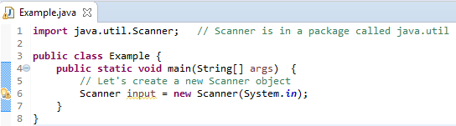
Console Input and Output
Input is a bit more challenging. We need to use the Scanner class to create an object that can read from System.in , as follows:
Notice: Objects in Java are declared with the new keyword!

Slide 7
Console Input and Output
If we want to get an integer from the user, we call the .nextInt() method.
int sampleInt = input.nextInt();
If we want to get a double from the user, we call the .nextDouble() method.
double sampleDouble = input.nextDouble();

Slide 8
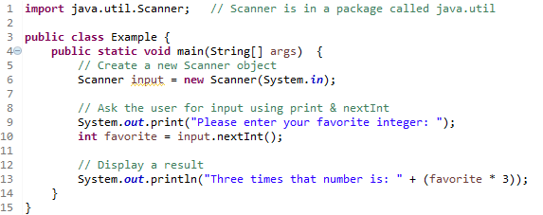

Console Input and Output
Once we have a scanner, we need to output any questions we ask the user before using the scanner to retrieve their response:
Notice: Just like in Python, we can output the value of a variable or a calculation.

Slide 9
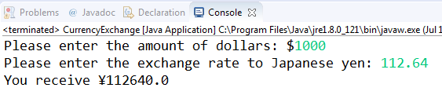
Currency Conversion (Group Work)
You are planning a trip to Japan. Write a class called CurrencyExchange that calculates the amount of local currency (yen) you will receive for any given amount of dollars and exchange rate.

Slide 10
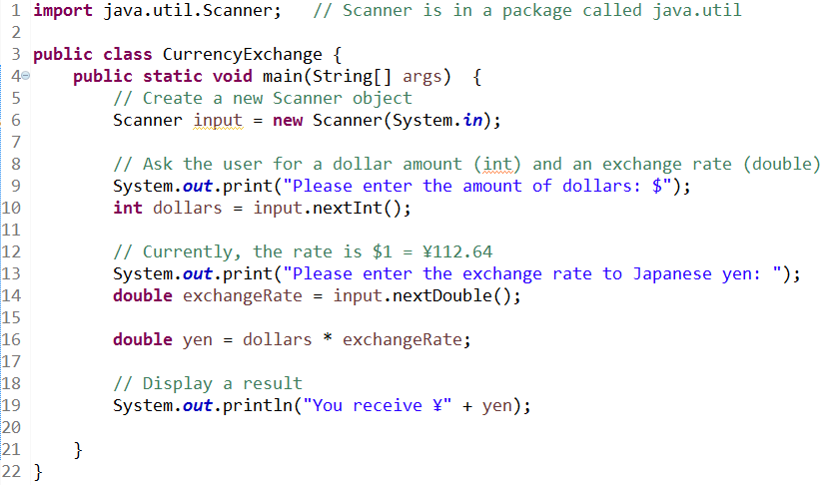
Currency Conversion (Answer)

Slide 11
Augmented Assignment Operators
Operator | Description | Example
+= | Add and Assign | num += 2;
-= | Subtract and Assign | points -= 5;
*= | Multiply and Assign | base *= 3;
/= | Divide and Assign | remnant /= 4;
%= | Assign integer remainder | left %= 10;

Slide 12
Increment / Decrement
In Python, we often used augmented assignment operators to increment or decrement by 1:
count += 1
points -= 1
In Java, there are dedicated increment and decrement operators:
count++; // This adds 1
points--; // This subtracts 1

Slide 13
Types
Python is a dynamically-typed language. This means that variables can store multiple types of data over the course of a program, and most type conversion happens automatically.
Java is a statically-typed language. Once you assign a type to a variable, this cannot be changed! You will often need to convert data types as a result. This is called casting.

Slide 14
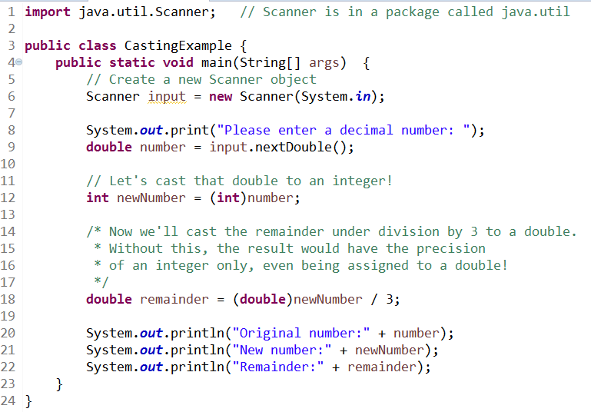
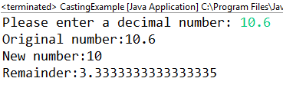
Casting (Type Conversion)
The following program illustrates casting:

Slide 15
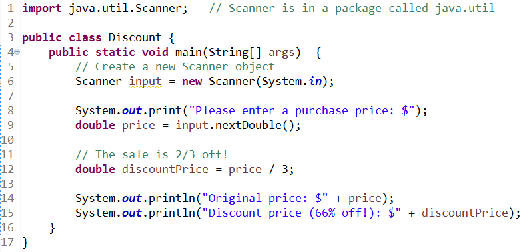

Rounding
It’s common for math involving doubles and division to have long trailing decimals:

Slide 16
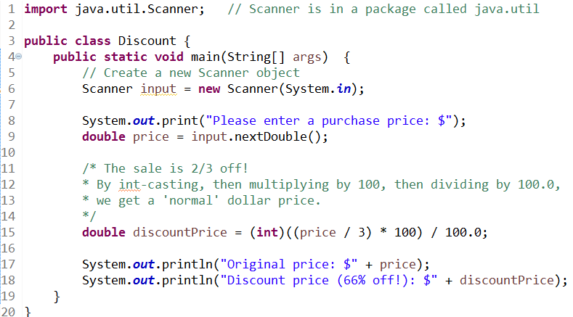

Rounding
Using casting to our advantage can solve that!

Slide 17
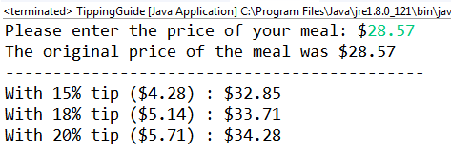
Tipping (Group Work)
Replicate the TippingGuide class, which allows you to quickly calculate common tip percentages:
Don’t duplicate code! Find a way to only calculate the tip once for each percentage.

Slide 18
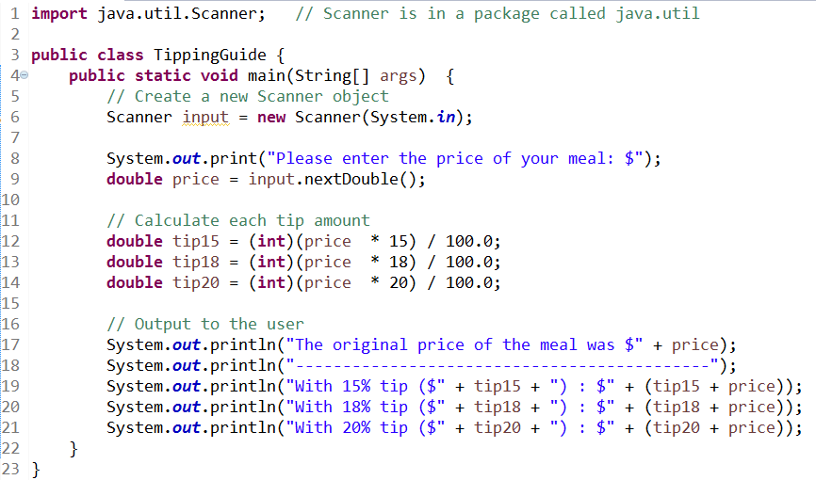
Tipping (Answer)

Slide 19
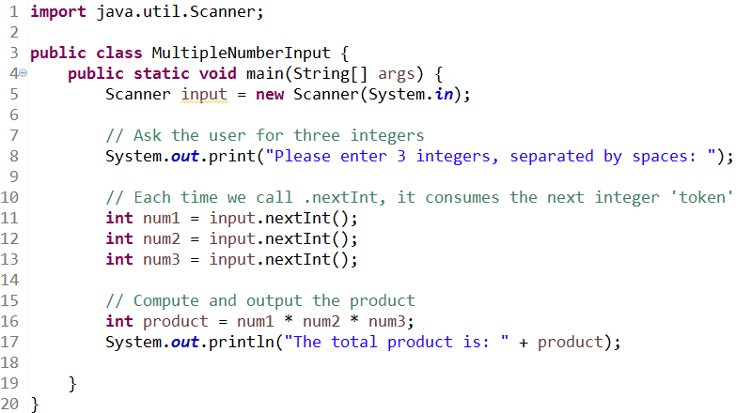

Console Input
Because of how Java’s input stream from the console works, we can enter multiple pieces of information on the same line, and acquire these with separate method calls:

Slide 20
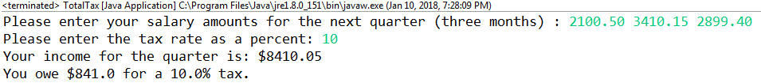
Taxes (BONUS Group Work)
For 3 Bonus points, write a program that can compute the tax owed on a quarterly salary made up of three amounts entered on the same line, as follows:

Slide 21
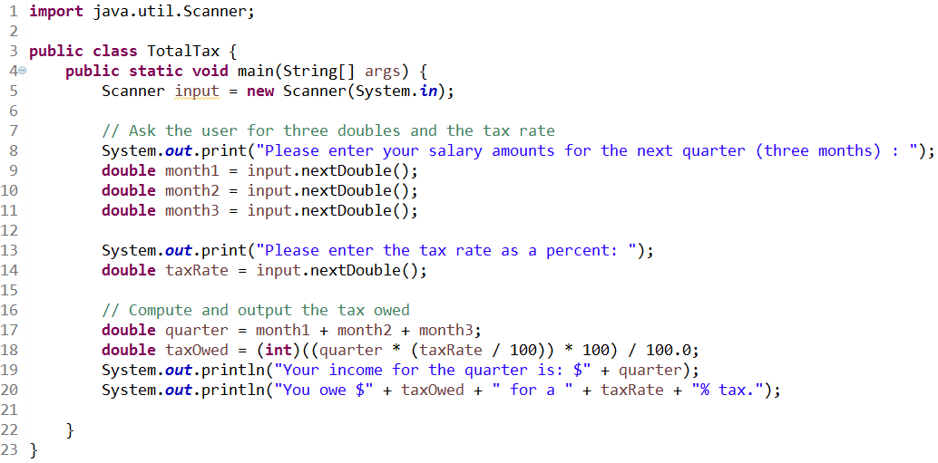
Taxes (Answer)

Slide 22
Questions?

